Slide 1
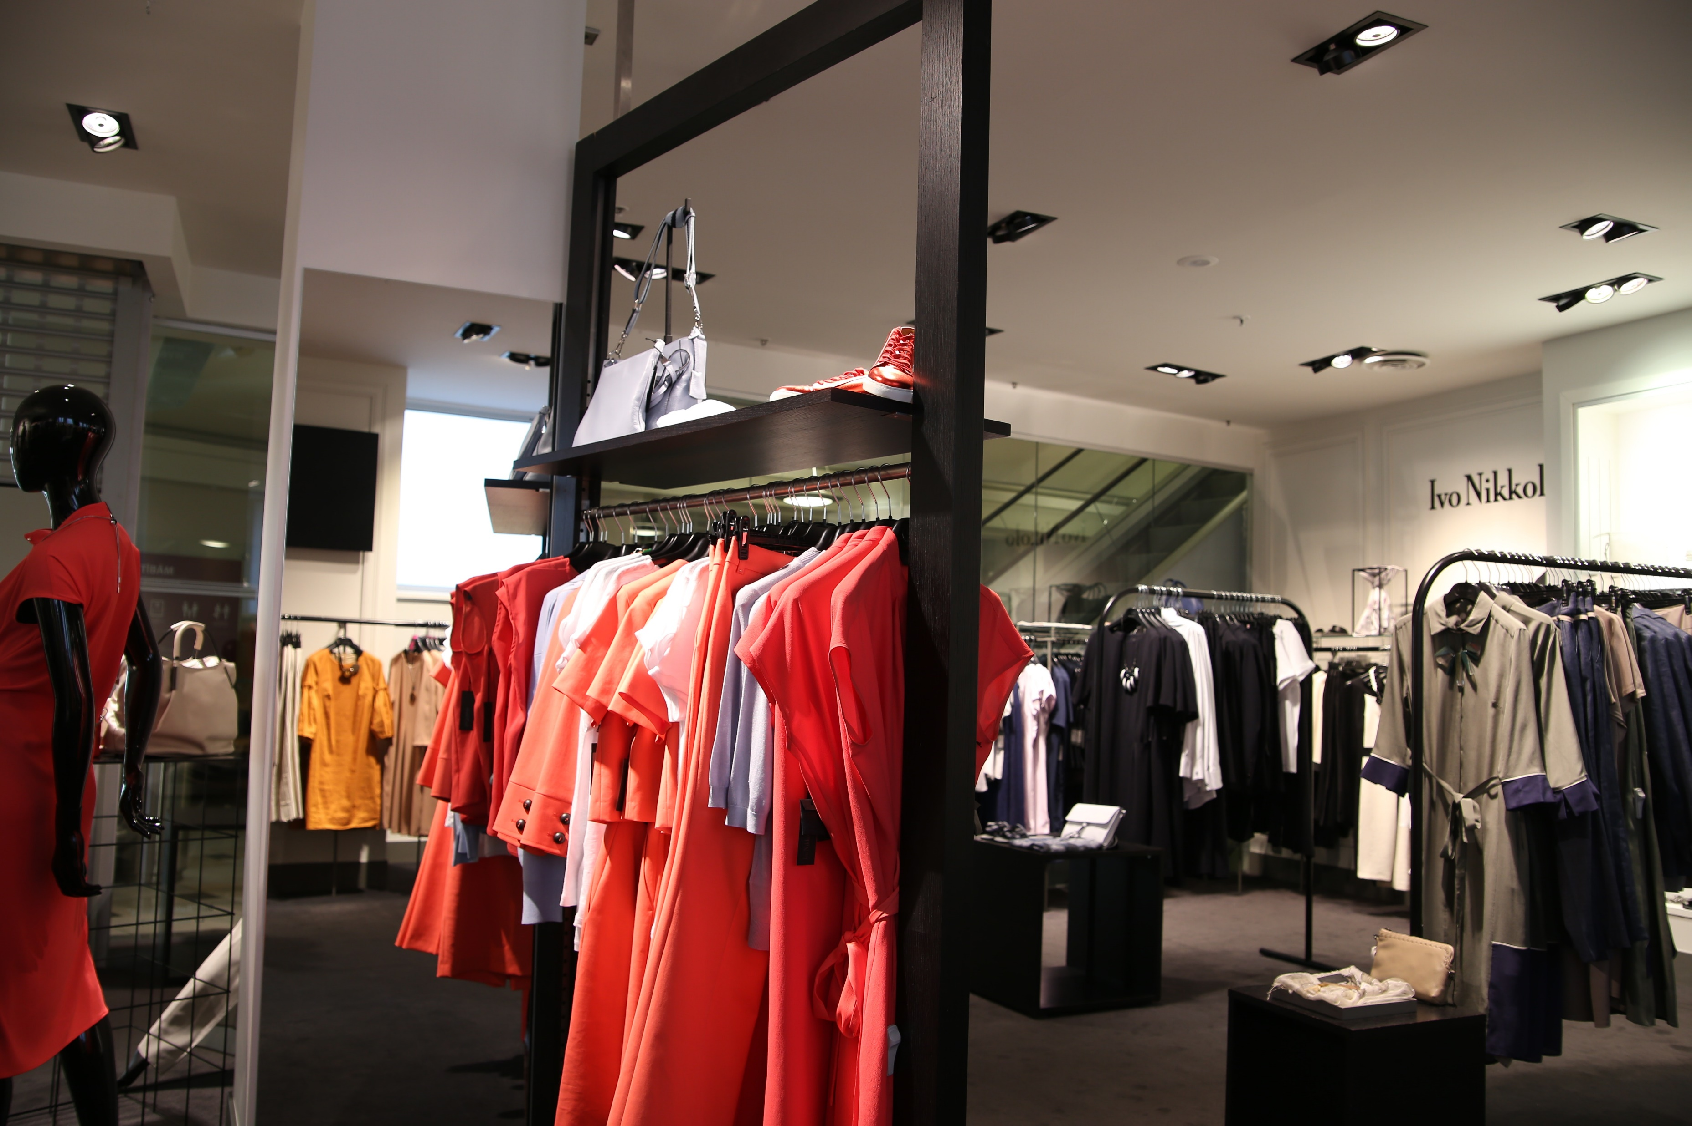
VRINDA STORE

Slide 2
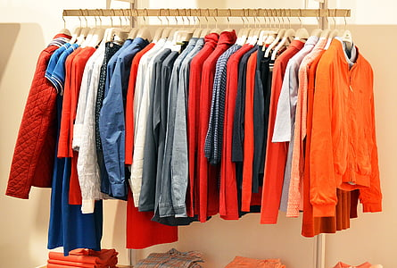
OBJECTIVES
'Vrinda Store Report 2022' aimed to help the store create an annual sales report, analyze customer behavior, and boost customer sales.

Slide 3
PROBLEM STATEMENT
Comparing the sales and orders using a single chart
Which month got the highest sales and orders
Who purchased more men or women in 2022 What are different order statuses in 2022
List top 10 states contributing to the sales
Relation between age and gender based on the number of sales
Which channel is contributing to maximum sales

Slide 4
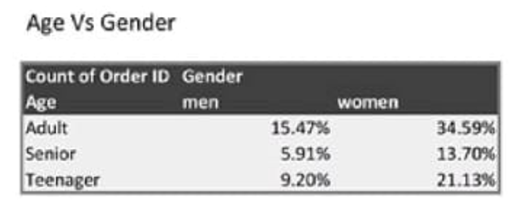
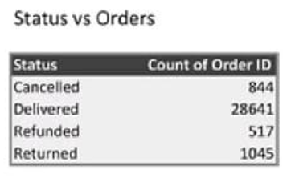
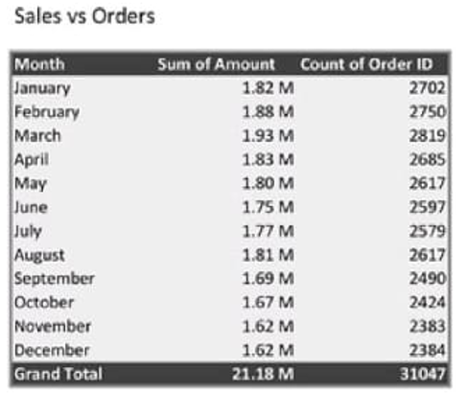
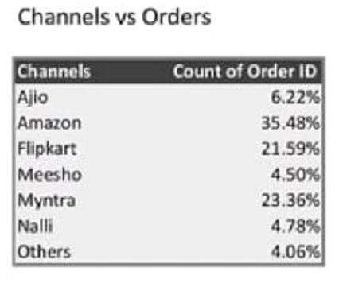
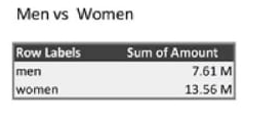
PIVOT Tables

Slide 5
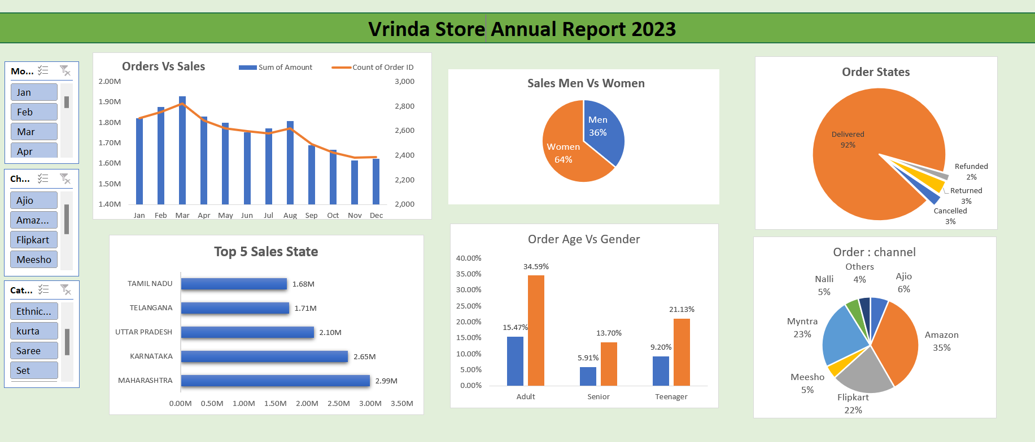

Slide 6
SAMPLE INSIGHTS
Based on the report insights, here are the outcomes of the sales: -
Women are more likely to purchase (65%) than men.
Maharashtra, Karnataka, and Uttar Pradesh were the top contributors to sales (35%).
The adult age group (30-49 yrs.) made the most contributions (50%).
Amazon, Flipkart, and Myntra channels were the top contributors (80%).

Slide 7
CONCLUSION
The final conclusion to improve store sales is to target women customers of the age group (30-49 yrs.) living in Maharashtra, Karnataka, and Uttar Pradesh by showing ads/offers/coupons available on Amazon, Flipkart, and Myntra

Slide 8
Thank you

